Slide 1
Data Representation
Mr Butler

Slide 2
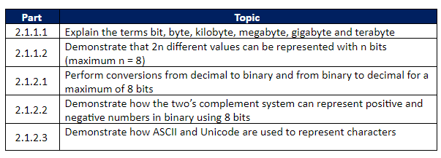
The Specification

Slide 3
Units of Storage
Computers use a variety of memory techniques to store data. All data is stored in digital format using a number system known as binary. A Binary digIT (known as a BIT) is either a 0 or a 1.
It is the smallest unit of storage.
When bits are grouped together, typically eight, it is referred to as a byte.
A single character (such as a letter or digit) is typically represented by a byte. The capacity of storage in a typical computer or peripheral is measure in bytes.

Slide 4
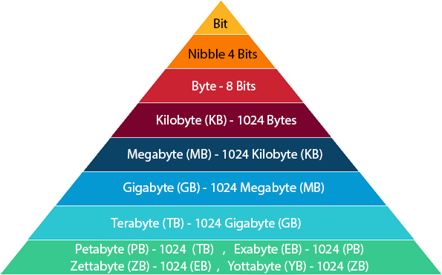
These terms are usually used to describe disk capacity, or data storage capacity, and system memory. Today, Terabyte is the common term being used to describe the capacity of a hard drive.

Slide 5
Activity: Mini Web Questions
Explain what is meant by the term, ‘bit’
Explain what is meant by the term, ‘byte’
Explain why the letter A would take up one byte of storage space
Explain what is meant by the term, ‘kilobyte’
In your own words, give an example to explain how much information can be stored in a kilobyte
Explain what is meant by the term, ‘megabyte’
In your own words, give an example to explain how much information can be stored in a megabyte
Explain what is meant by the term, ‘gigabyte’
In your own words, give an example to explain how much information can be stored in a gigabyte
Explain what is meant by the term, ‘terabyte’
In your own words, give an example to explain how much information can be stored in a terabyte
Notes:
http://www.teach-ict.com/gcse_new/computer%20systems/storage_units/miniweb/index.htm

Slide 6
Challenge Questions
Calculate the number of bytes in a 2 Gigabyte USB memory pen?
Calculate the number of Megabytes on a 1 Terabyte hard drive?
How many bits are in a 5MB sound file?

Slide 7
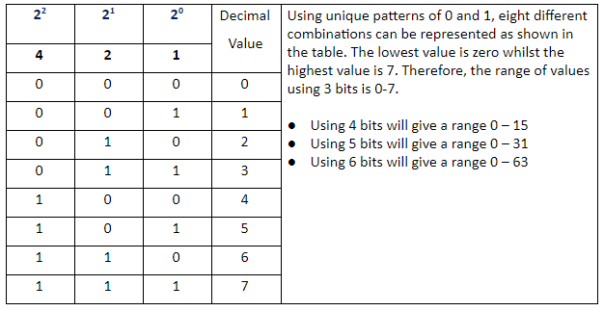
The range of values that can be represented using n bits
The number of bits used will determine the number of different values that can be represented. The greater the number of bits the greater the number of values.
For example, if we use 3 bits, this will allow eight different values as shown below.

Slide 8

Notes:
Binary and Data Video

Slide 9
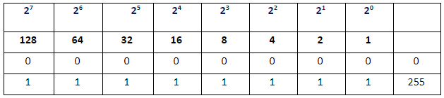
If we consider 8 bits the lowest value will be 0 and the highest value will be 255 as shown below. The bit position on the right hand side is referred to as the least significant bit (LSB) whereas the bit position on the left hand side is referred to as the most significant bit (MSB)
Therefore, in general terms 2^{n} different values can be represented with n bits.
Although 2⁸ has a value of 256, the highest value is 255 because we include zero in the range of combinations of an 8 bit pattern.
To calculate the range of values for n bits we can apply the following rule 0 – (2^{n}-1).
Most Significant Bit
Least Significant Bit

Slide 10
Activity: Read and Complete
1 bit = | 2¹= 2 numbers can be represented (0-1)
2 bits = | 2²= 4 numbers can be represented (0-11)
3 bits =
4 bits =
5 bits =
6 bits =
7 bits =
8 bits =
Notes:
http://www.teach-ict.com/gcse_computing/ocr/214_representing_data/number/miniweb/pg2.php

Slide 11

Perform conversions from decimal to binary and from binary to decimal for a maximum of 8 bits
In the decimal (sometimes referred to as denary) numbering system, each integer number column has values of units, tens, hundreds, thousands, etc. as we move along the number from right to left.
Mathematically these values are written as index numbers starting from the right-hand side 10⁰, 10¹, 10², 10³ etc.
Then each position to the left of the decimal point indicates an increased positive power of 10.

Slide 12
The Binary Numbering System is used in all digital and computer based systems.
Binary numbers follow the same set of rules as the decimal numbering system.
The main difference is the decimal system uses powers of ten whereas the binary numbering system works on powers of two. Each binary place value can be converted to an equivalent decimal number
Binary | 2⁷ | 2⁶ | 2⁵ | 2⁴ | 2³ | 2² | 2¹ | 2⁰
Decimal | 128 | 64 | 32 | 16 | 8 | 4 | 2 | 1

Slide 13
Convert the following decimal number to binary using 8 bits
(1) 51
(2) 101
(3) 83
(4) 164
(5) 11
(6) 256

Slide 14
Convert the following binary numbers to decimal:
(1) 1011 0011₂
(2) 0101 0101₂
(3) 0011 0011₂
(4) 1111 1111₂
(5) 0111 1011₂
(6) 1110 0001₂

Slide 15
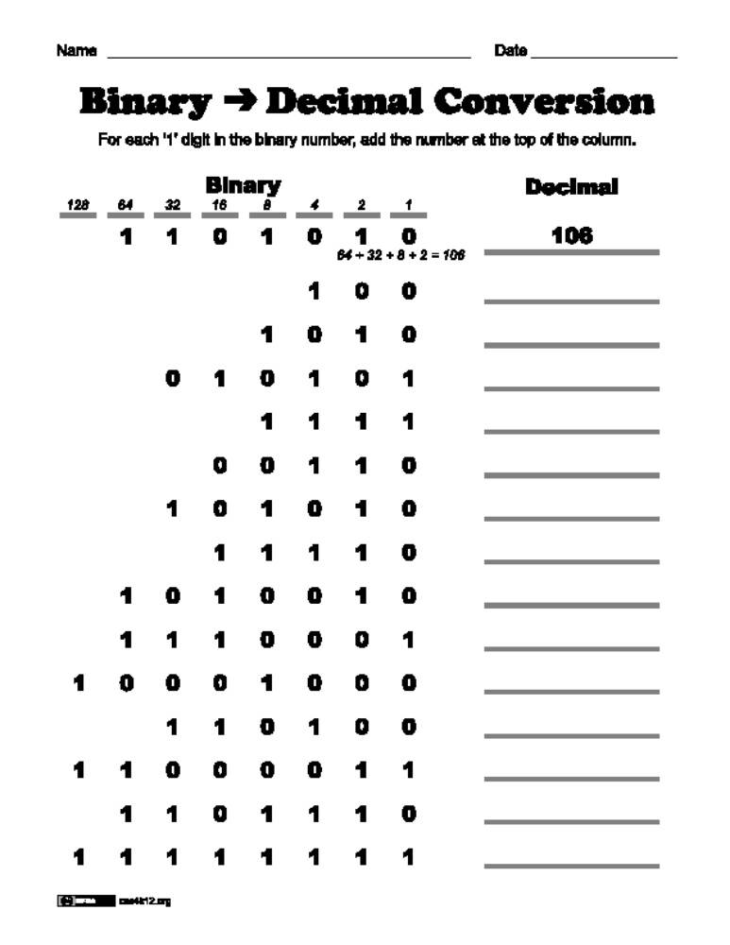
Worksheet: Binary to Decimal

Slide 16


2s Complement
https://www.bbc.com/education/clips/zprj2hv

Slide 17
Consider the problem of representing both positive and negative integers over a given range in terms of only using ones and zeroes. This would mean we have to build in the sign as part of the binary representation.
We can represent a negative number in binary by making the most significant bit (MSB) a sign bit, which will tell us whether the number is positive or negative. In two’s complement if the MSB has a value of 1 then the number will have a negative value and if the MSB is 0 then the number will have a positive value.

Slide 18
Question Break
Q. Convert each of the following two’s complement binary numbers into decimal.
Show your working out.
00001111₂
11100001₂
[4]

Slide 19
Question Break – Mark Scheme
00001111₂
most significant bit is 0, so is positive.
+15
11100001₂
-31
-128 | 64 | 32 | 16 | 8 | 4 | 2 | 1
0 | 0 | 0 | 0 | 1 | 1 | 1 | 1
 |  |  |  | 8 + | 4 + | 2 + | 1 = 15
-128 | 64 | 32 | 16 | 8 | 4 | 2 | 1
1 | 1 | 1 | 0 | 0 | 0 | 0 | 1
-128 + | 64 + | 32 + |  |  |  |  | 1 = -31

Slide 20
The column headings for an 8 bit two’s complement number will look like this:
The range of decimal values using 8 bits twos complement is -128 to +127. In general terms the range for n bits is (-2^{n-1)} to (2^{n-1}-1).
+/-128 | 64 | 32 | 16 | 8 | 4 | 2 | 1
MSB |  |  |  |  |  |  | LSB

Slide 21
One’s Complement
1's complement is a very easy method for representing negative numbers in binary number system.
To represent any number which is negative first we have to consider the binary value of its positive magnitude in binary system, then we have to simply convert the 1’s with 0 and the 0s with 1 and we will get the 1's complement of that number which is also the negative value of that number.

Slide 22
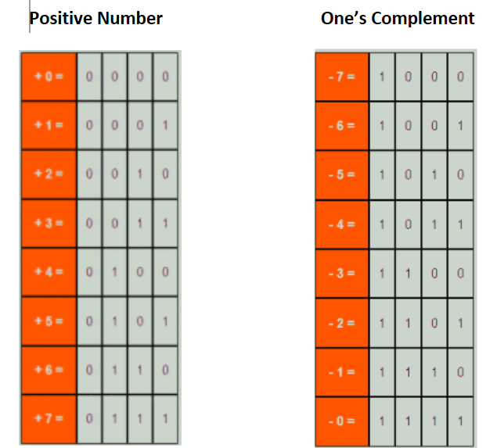

Slide 23
“Sir, so why not just use One’s Complement?”
Two's-complement has the advantage that there is only one bit representation for zero.
e.g. 1000 and 0000 in 1’s complement are both zero!
Two representations of zero would lead to problems in many programs. (Think: if a == 0)
Adding and subtracting is also more straightforward in 2's complement. It works the same on two integers, whether positive or negative.

Slide 24
https://www.bbc.co.uk/bitesize/guides/zwsbwmn/test

Slide 25
Demonstrate how ASCII and Unicode are used to represent characters
A character set is a set of symbols that may be represented in a computer at a particular time.
These symbols, called characters, can be classified as letters, digits and punctuation marks.
A character set also contains “control” characters which are non-printing and are used for special purposes such as an end of file marker.
Two examples of character sets are ASCII and Unicode.
ASCII (American Standard Code for Information Interchange)

Slide 26
ASCII
ASCII uses a 7 bit code and represents 128 characters including control characters. The characters are coded as consecutive numbers from 0 to 127.
These characters and control codes are encoded as simple, unsigned, binary integers.

Slide 27
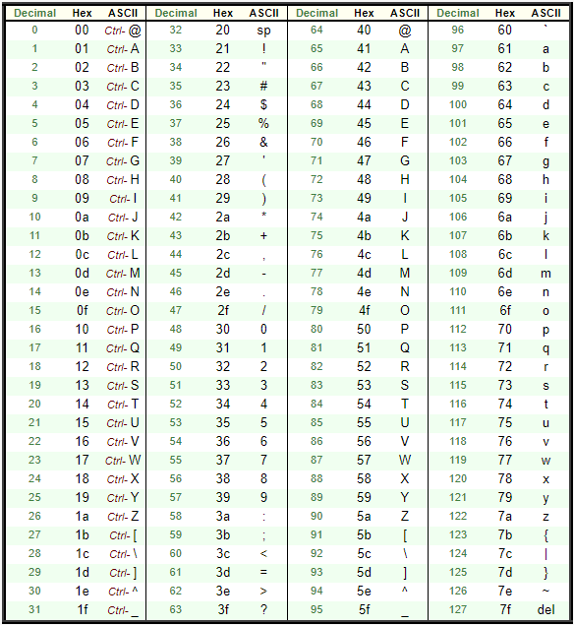
Every character has a unique binary pattern

Slide 28
ASCII
ASCII was designed to represent English-language text for an American user base, and is therefore insufficient for representing text in almost any language other than American English.
The 8th bit can be used for error checking.
Alternatively, ASCII can represent 28 characters/ASCII uses 8 bits to represent 256 characters.

Slide 29

ACSII
ASCII uses 8 bits to represent a character.
However, one of the bits is a parity bit. This is used to perform a parity check (a form of error checking). This uses up one bit, so ASCII represents 128 characters (the equivalent of 7 bits) with 8 bits rather than 256.
For example, the ASCII code for lower case z is 122 and is shown below:

Slide 30
Parity Bits
A particular data communications system represents characters using ASCII with odd parity.
This means each 7-bit ASCII character is followed by a parity (check) bit
The ASCII code for ‘J’ is 74, which is represented in binary as 1001010
  As there are three 1s in this number, the digit 0 is added at the end
  So 10010100 is actually transmitted.
  If during transmission there is any interference/corruption/error and one of the bits is changed – for example 11010100 – the computer recalculates and determines the parity bit should be 1 (as there is an even number of 1s), then the computer knows an error has occurred and can request to be retransmitted.

Slide 31
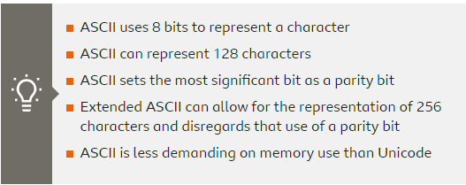
Extended ASCII
It is possible to disregard the use of a parity bit to allow ASCII to represent 256 characters. This is known as extended ASCII.
There are different versions of extended ASCII in use.
The 128 or 256 character limits of ASCII and Extended ASCII limits the number of character sets that can be held.
Representing the character sets for several different language structures is not possible in ASCII, there are just not enough available characters.

Slide 32
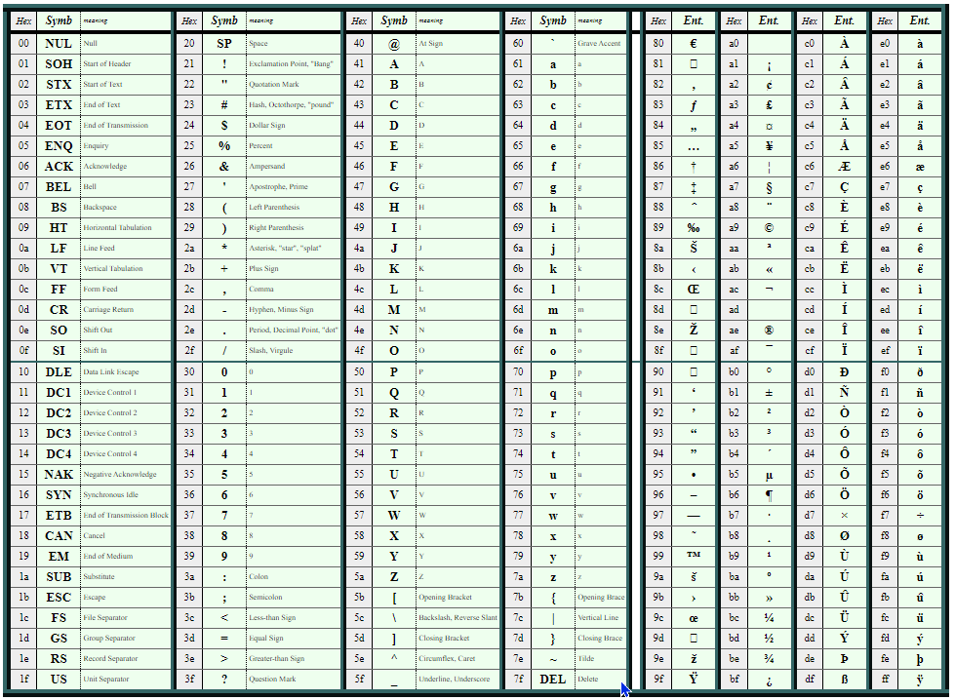
ASCII: Extended Version

Slide 33
Unicode
Unicode is a worldwide character standard. It allows for the interchange, processing, and display of the written texts of the majority of the diverse languages of the modern world. Whereas ASCII was limited to American English characters
Therefore, it is a single-coded character set that incorporates characters from almost all the worlds’ languages.
To allow for the increase in representing characters Unicode is a 16 bit extension (to represent 65536 characters) of ASCII code.

Slide 34
Question Questions
How many possible characters can be represented using the ASCII character set?
How many possible characters can be represented using the Unicode character set?
Using ASCII, write Enniskillen Royal Grammar School in binary.

Slide 35
Revision Worksheet
WORKSHEET - Binary, denary and two's complement

